Slide 1
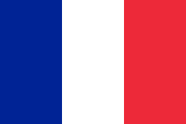
Francja
Położenie, potrawy, tradycje, język, zabytki, stroje narodowe

Slide 2
France location
This is a map of Europe, France is there,
It is located in Western Europe
France is situated on the Bay of Biscay, the Lamanche Canal and the Atlantic Ocean

Slide 3
The traditions of France
On July 14, the great French Revolution took place, then they overthrew the French monarchy, they celebrate this holiday every year,
the French are often dressed elegantly
On February 2, the day of the pancake is celebrated in France
In France, it is not a fat Thursday, but a fat Tuesday,
Paris is associated with the capital of fashion,

Slide 4
Food in France
characteristic meals in France is : onion soup with croutons, snails, Beef Bourguignon, oysters, salad nicoise, frog legs, Ratatouille, bouillabaisse soup, Beans from Toulouse, Strasbourg pate, and other good meals,
these meals are very good for the French and for tourists,

Slide 5
What is worth visiting while in France ?
in France, it is worth visiting the capital city Paris,
In Paris there are 3 must see places ; Eiffel Tower, museum Louvre and Notre-dame cathedra,
the most famous painting of a Monalis is in the Louvre

Slide 6
Language in France
In France language French is used,
French is also spoken in Belgium and part of Africa,

Slide 7
Monuments in France
There are beautiful sights in France for example ; Notre-dame cathedra, Palace of Versailles, Eiffel Tower, Etretat, Normandia, Mont-Saint Michel, Normandia,

Slide 8
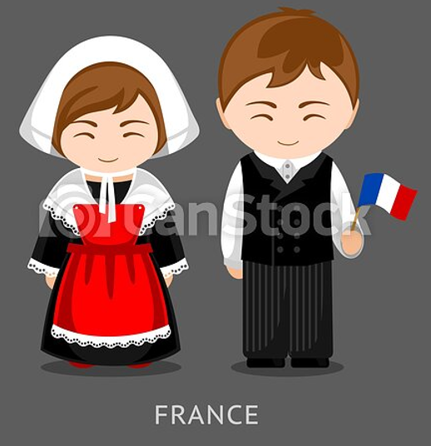
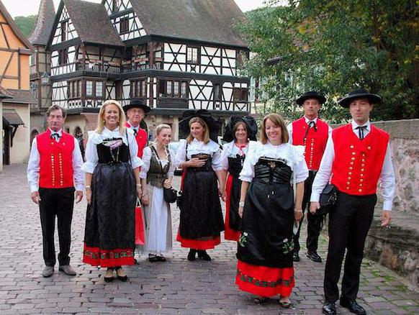
National costumes
The French national costume was created in the XVII century,
These outfits are most often made of wool and soft fabrics
The photos show the national costumes of the French,

